Slide 1
Computer Networks
PPT-1: Overview of Computer Networks
Anand
Department of Computer Science
Keshav Mahavidyalaya

Slide 2
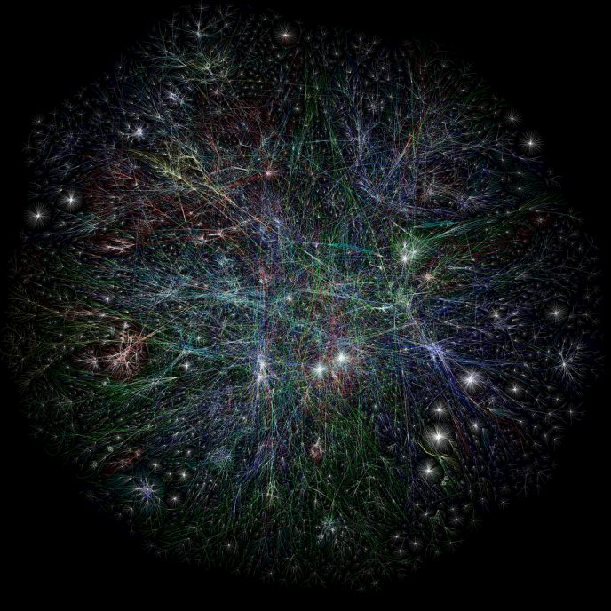
What is a computer network
A computer network is a set of interconnected computers that communicate with each other and share resources.
The purpose of a computer network is to enable the exchange of information and resources among different devices.
Ref. Partial map of the Internet based on the January 15, 2005 data found on opte.org Computer Network Wikipedia

Slide 3
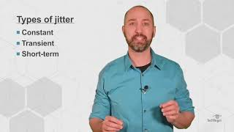
Characteristics of Computer Network
Delivery : Sending to correct destination
Accuracy : No mismatch in Data / Error Free
Timeliness : It should reachin proper time
Jitter : Variation in packet delivery delay

Slide 4
Features of a Computer Network
Connectivity
Scalability
Reliability - fault tolerance
Performance: Throughput & delay
Security
Interoperability
Manageability
QoS
Flexibility
Distributed Processing
Resource Sharing
Accessibility
Cost-Effectiveness
Adaptability
Standardization
Performance can be measured in many ways, including transit time and response time. Transit time is the amount of time required for a message to travel from one device to another. Response time is the elapsed time between an inquiry and a response.

Slide 5
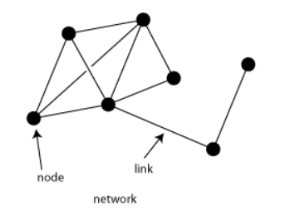
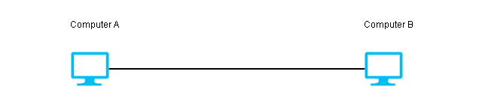
Key components
Message: Information that is to be transmitted. E.g. Text, Numbers, Pictures, Audio , Video etc.
Nodes/Devices: These are the individual computers, servers, printers, routers, and other devices that are connected to the network.
Communication Links: These are the physical or wireless connections that allow data to be transmitted between nodes.
Protocol : Set of Rules that govern the data communication.

Slide 6
Data Representation
Text : Represented as bit patterns or sequence of bits ( 1100110)
Numbers : Bit Pattern
Images : Matrix of pixels
Black or white (0/1)
Gray color (0-255)
Color Image 3 Matrices, one for each color (RGB)
Audio: voice , recording, music -> Analog to digital
VIdeo : Sequence of pictures which may include audio as well contained in a single file

Slide 7
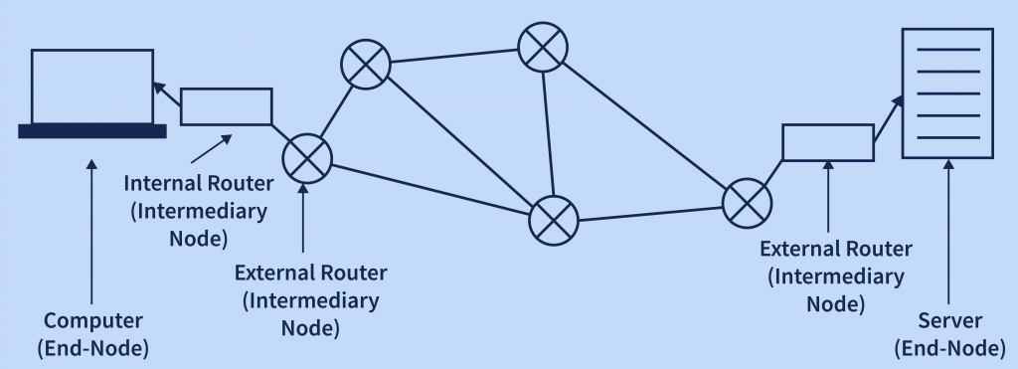
Typical Elements of a Network
Node
End Devices
Intermediary devices
Types of communication links
Wired
Wireless

Slide 8
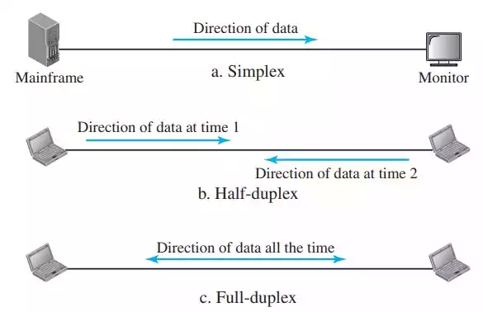
Transmission Modes
Simplex
TV Transmission
Keyboard
Monitor
Half Duplex
Walkie talkie
Full Duplex
Telephone

Slide 9
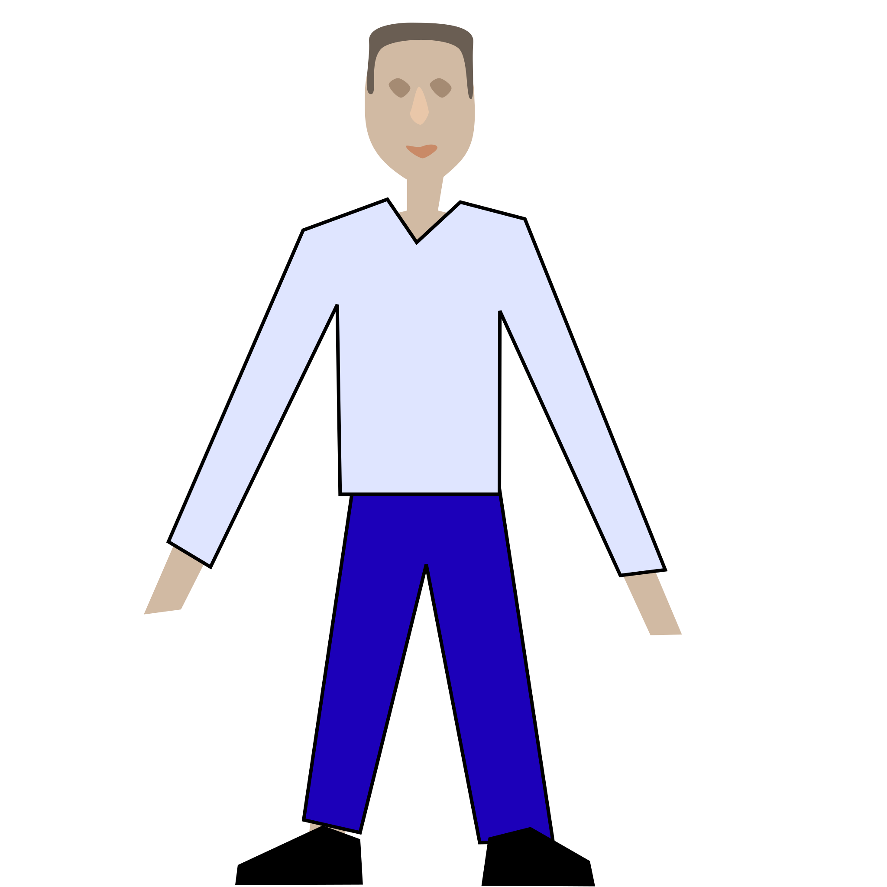
Protocols
A protocol is a set of rules and conventions that govern how data is exchanged and transmitted between devices within a network. They ensure that devices from different manufacturers or running different software can communicate effectively.
Protocols define:
Format
Timing
Sequencing
Error control
A
B

Slide 10
Elements of Protocol
Message Encoding
Message formatting and encapsulation
Message timing
Message size
Message Delivery Options

Slide 11
Message Encoding
Message Source
Message Destination
Encoder
(Signal)
Decoder
(Signal)
Transmitter
Receiver
Transmission Medium

Slide 12
Message Formatting
Agreed Format
Encapsulate to identify sender and receiver
Source and Destination address

Slide 13

Message Timing
Flow Control
Slow Receiver
High speed Sender
Response Timeout

Slide 14
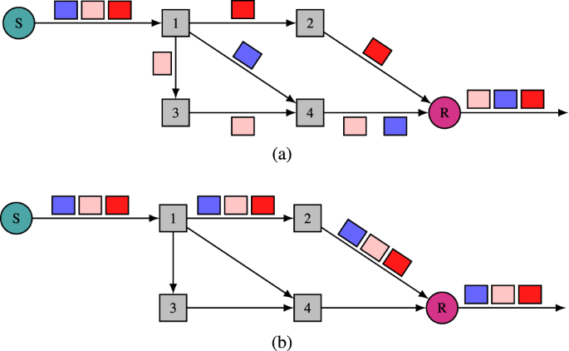
Message Size
Long messages must be broken into smaller pieces

Slide 15
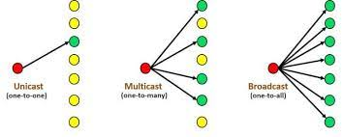
Message Delivery Options
Unicast
Multicast
Broadcast

Slide 16
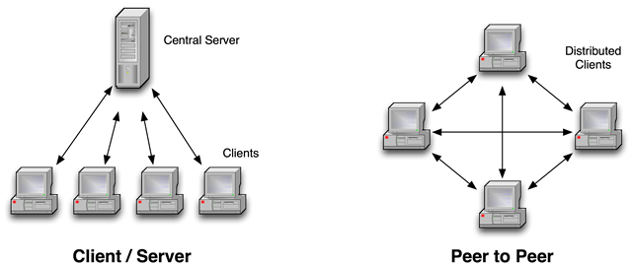
Network Architecture / Models

Slide 17
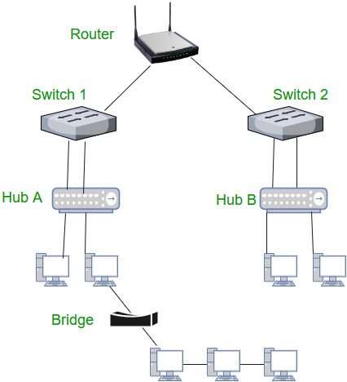
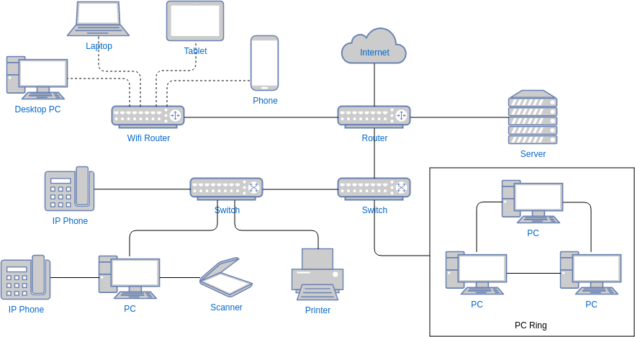
Equipment used in Computer Network
End Nodes
Computers
Network Printers
VOIP Phones
Network Security Cameras
Mobile Devices
Intermediary Devices
Repeater
Hub
Bridge
Switch
Router
Access Point
Modem
Firewall
Gateway

Slide 18
Equipment used in Computer Network
Communication Link (Media)
Wired or guided media
Ethernet straight through cable: for connecting different kind of devices
Ethernet Crossover cable: for connecting same kind of devices
Fiber optic cable
Co-axial cables
USB Cables
Wireless or unguided media
Infrared : TV Remote, AC remote ,etc…
Radio Waves: Wifi, Bluetooth
Microwaves: Cellular System, Satellite link

Slide 19
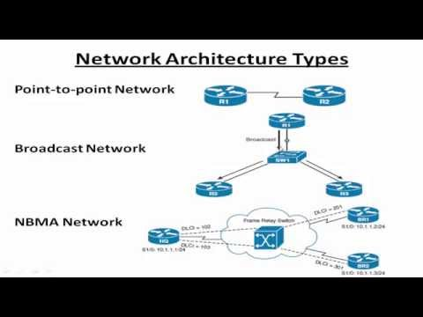
Network Taxonomy
1. Transmission Technology
Point to Point Network
Broadcast Network
Non Broadcast Multi Access Network
2. Scale
PAN
LAN
MAN
WAN
INTERNET

Slide 20
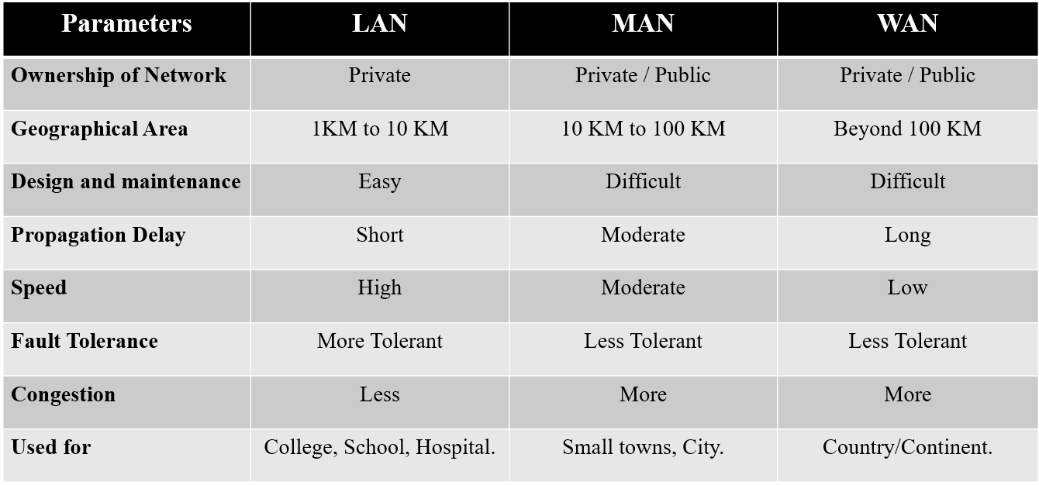
Classification on the basis of Scale

Slide 21
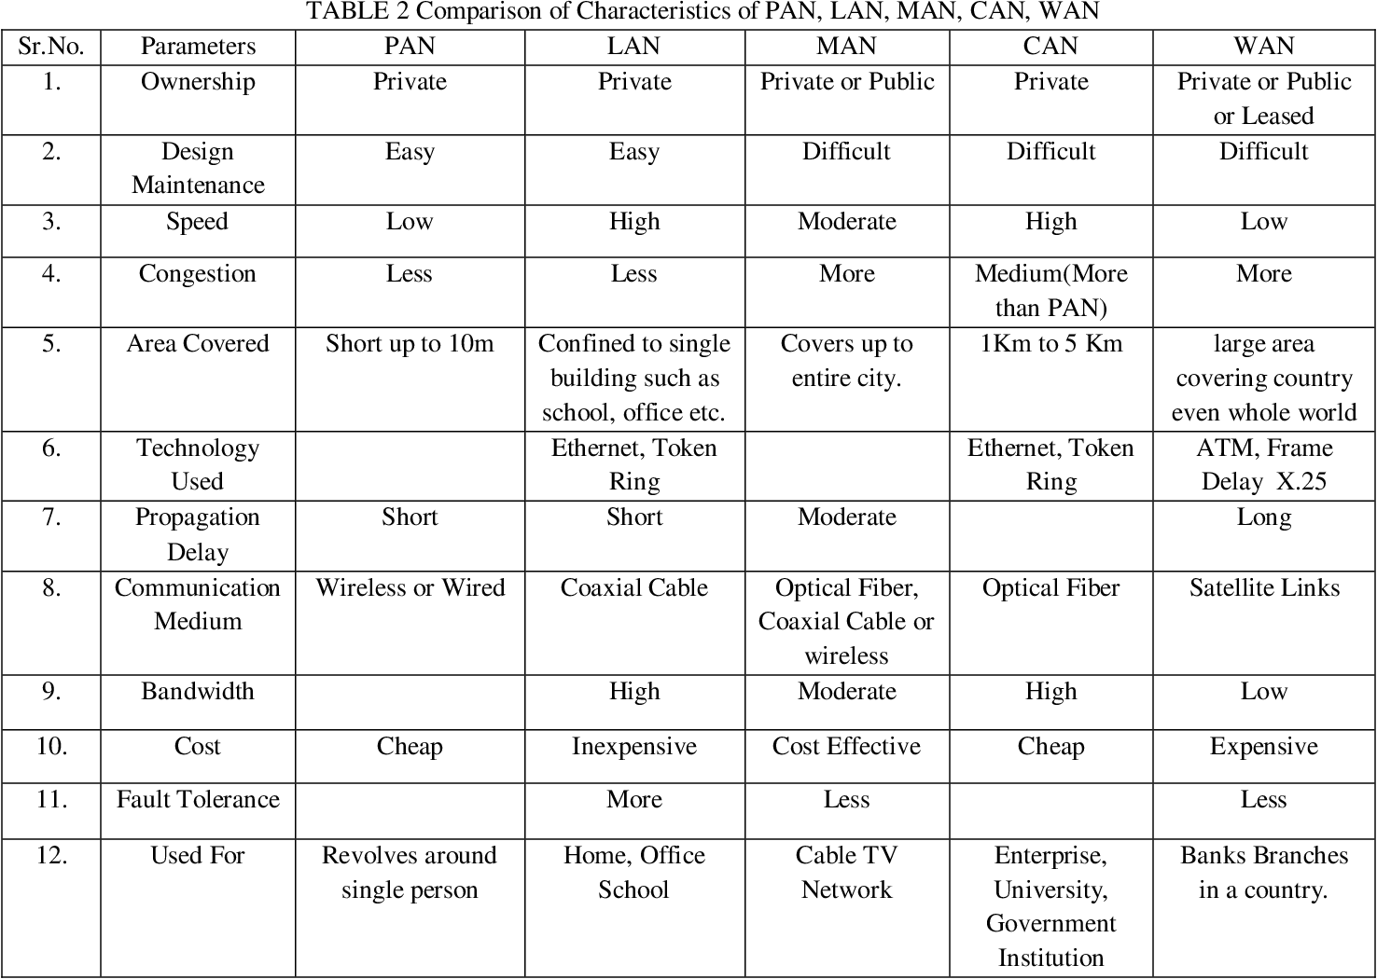

Slide 22
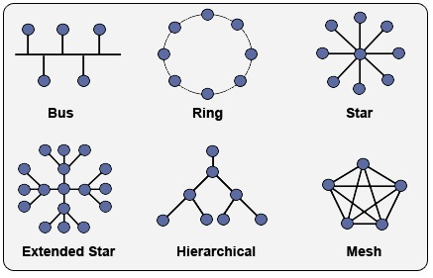
Next Lecture
Network Topology

